Slide 1
FieldShield AI
Protect Every Crop. Reduce Every Loss.
AI-powered intelligent agriculture.
https://fieldshield.ai.studio

Slide 2
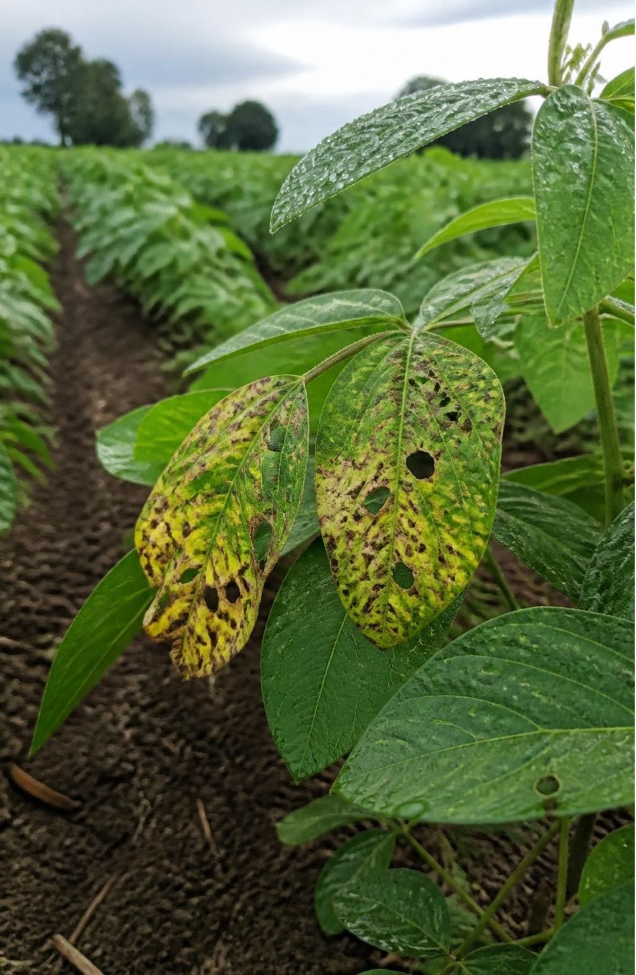
THE PROBLEM
Farmers face threats they see too late
Diseases and pests
Unpredictable weather
Crop damage can go unnoticed.
Floods, drought, heat and storms.
By the time damage is visible, harvests and productivity are already at risk.

Slide 3
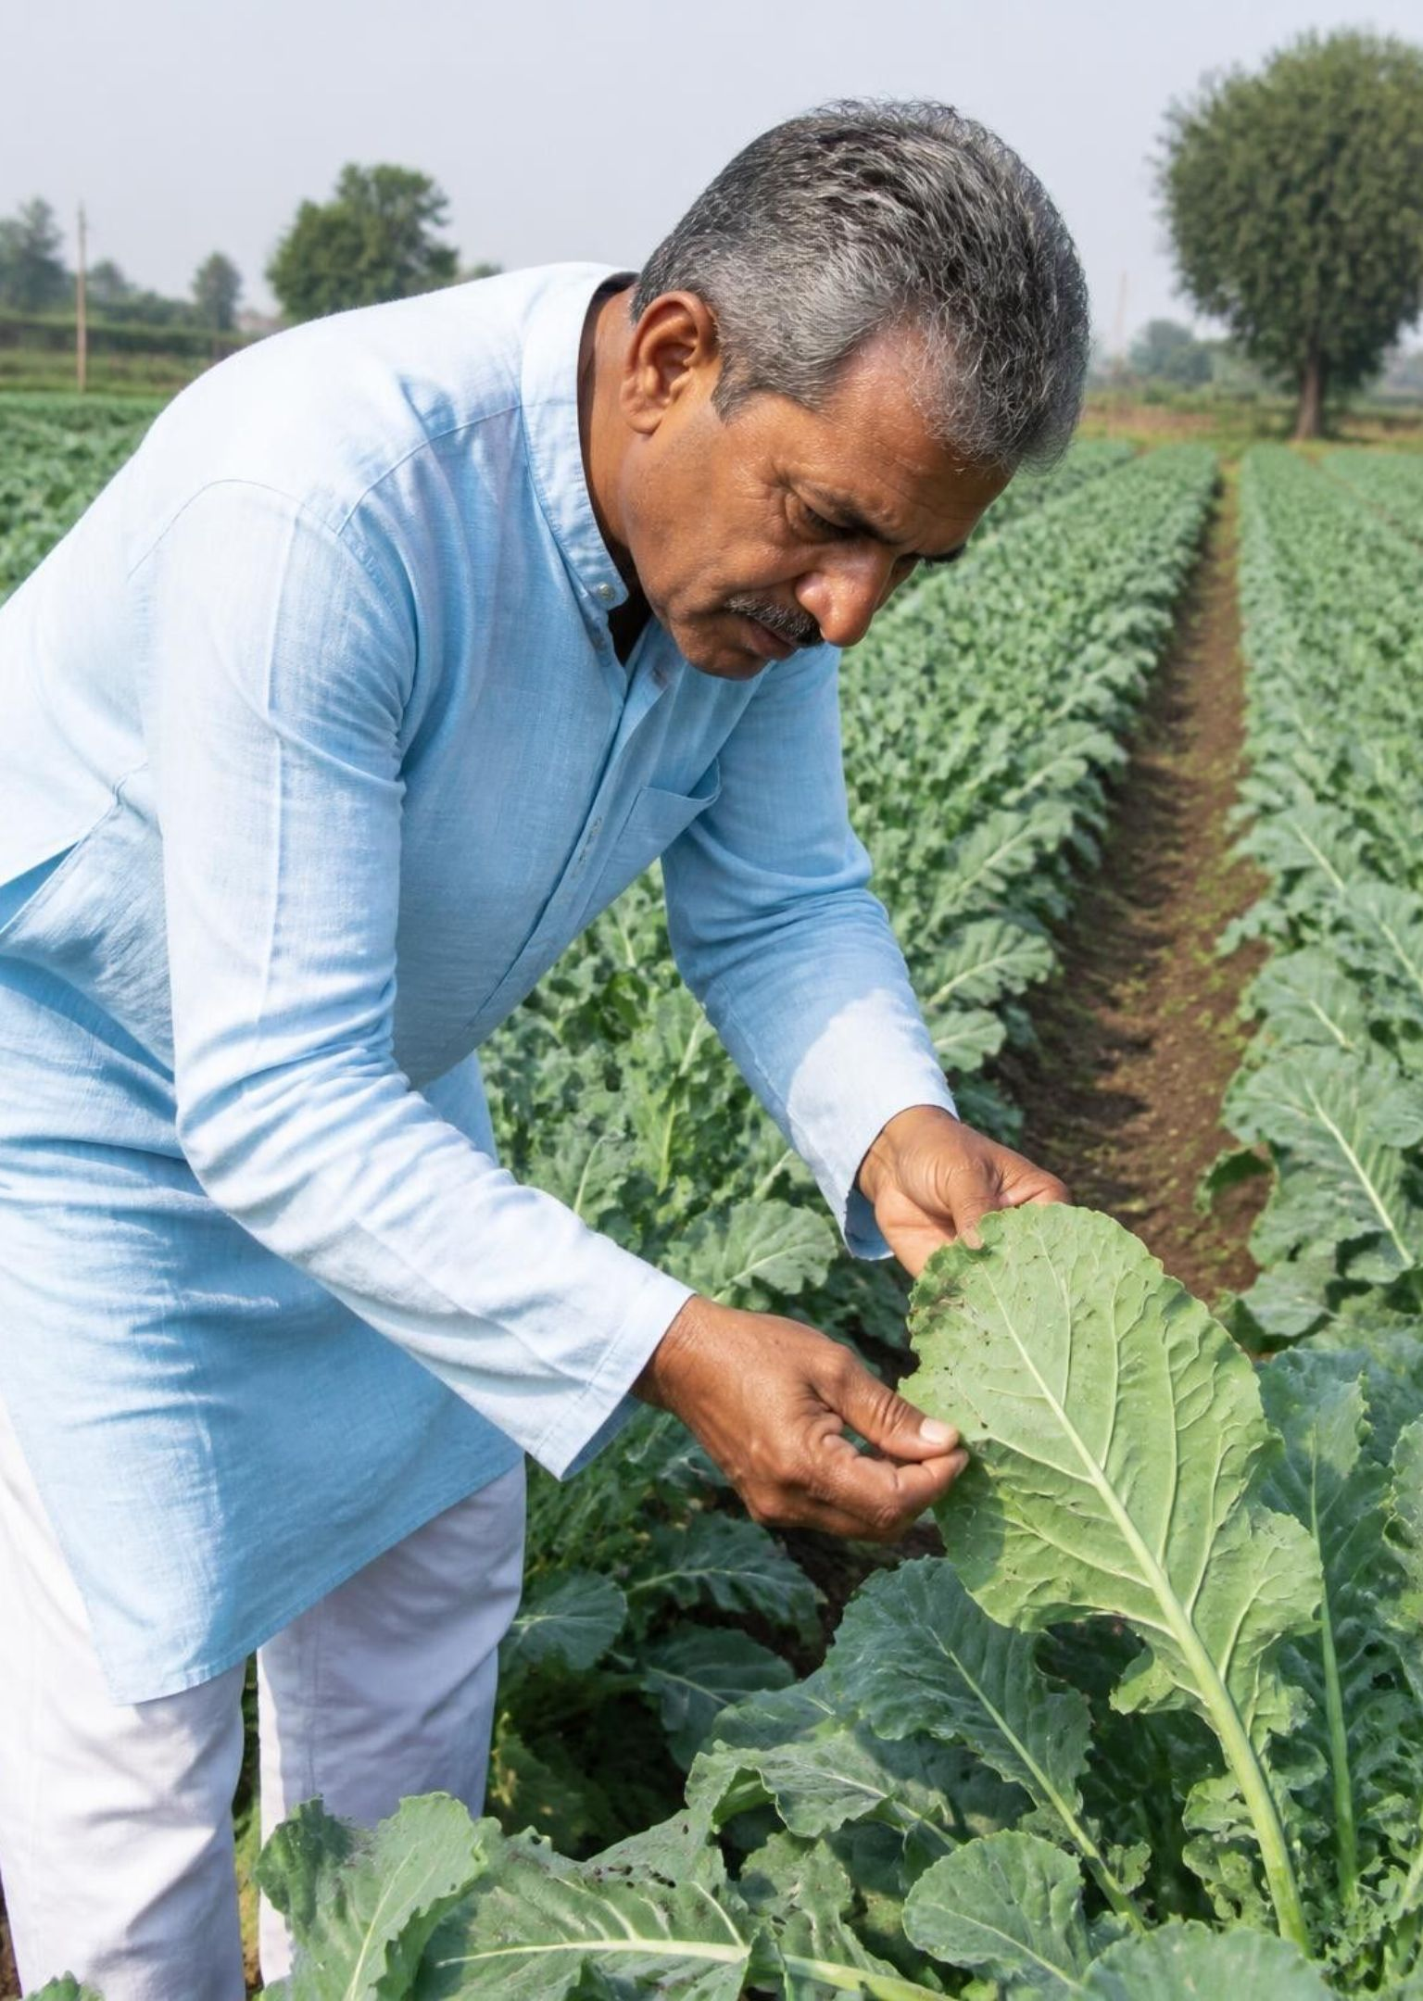



THE MONITORING GAP
Traditional monitoring can't keep pace
Manual observation
Farmers depend on what they can see.
Delayed detection
Problems surface after damage begins.
Too little actionable insight
Data-driven monitoring can support faster, better decisions.

Slide 4
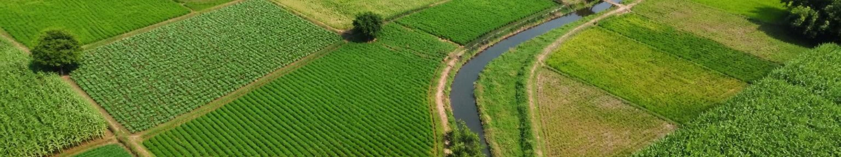
Meet FieldShield AI: a digital defense for every farm
A digital agricultural defense and farm demarcation platform.
11
Support across the crop lifecycle, from farm mapping to disaster recovery.
Protect Every Crop. Reduce Every Loss.
Indian languages

Slide 5
THE FARMER JOURNEY
How it works: from your farm to a warning
01
02
03
Input
Analysis
Output
Register the farm location, draw the cadastral boundary on Google Earth and set crop details.
24x7 satellite surveillance and multi-risk monitoring using IMD, Central Water Commission and Google Earth data.
Real-time warnings, automated alerts, parcel-level flood extent risk and recovery support.
Source: FieldShield AI · fieldshield.ai.studio

Slide 6








Eight risk modules, one farm shield
Floods
Drought
Heatwaves / Frost
Storms
Diseases
Pests
Soil stress
Storage losses
Farm maps combine satellite view, 3D terrain and river gauge levels.
Ask FieldShield AI, your 24/7 “Crop & Flood Buddy”.
72-hour
Government helplines: NDMA 1078 · Emergency 112 · State SDMA 1070
Crop inundation intimation portal for PMFBY farmers.

Slide 7
PLATFORM ARCHITECTURE
Trusted data and satellite imagery power the platform
Data sources
FieldShield AI
Farmer outputs
IMD
Central Water Commission
Google Earth satellite observation
Farm mapping and multi-risk monitoring.
AI assistant for farmer questions, around the clock.
Farm views
Real-time warnings
Automated alerts
Recovery support
→
→
Google Earth provides 3D terrain and high-resolution, multispectral cadastral imagery.
Model and algorithm details are not published, so none are claimed. Source: fieldshield.ai.studio

Slide 8
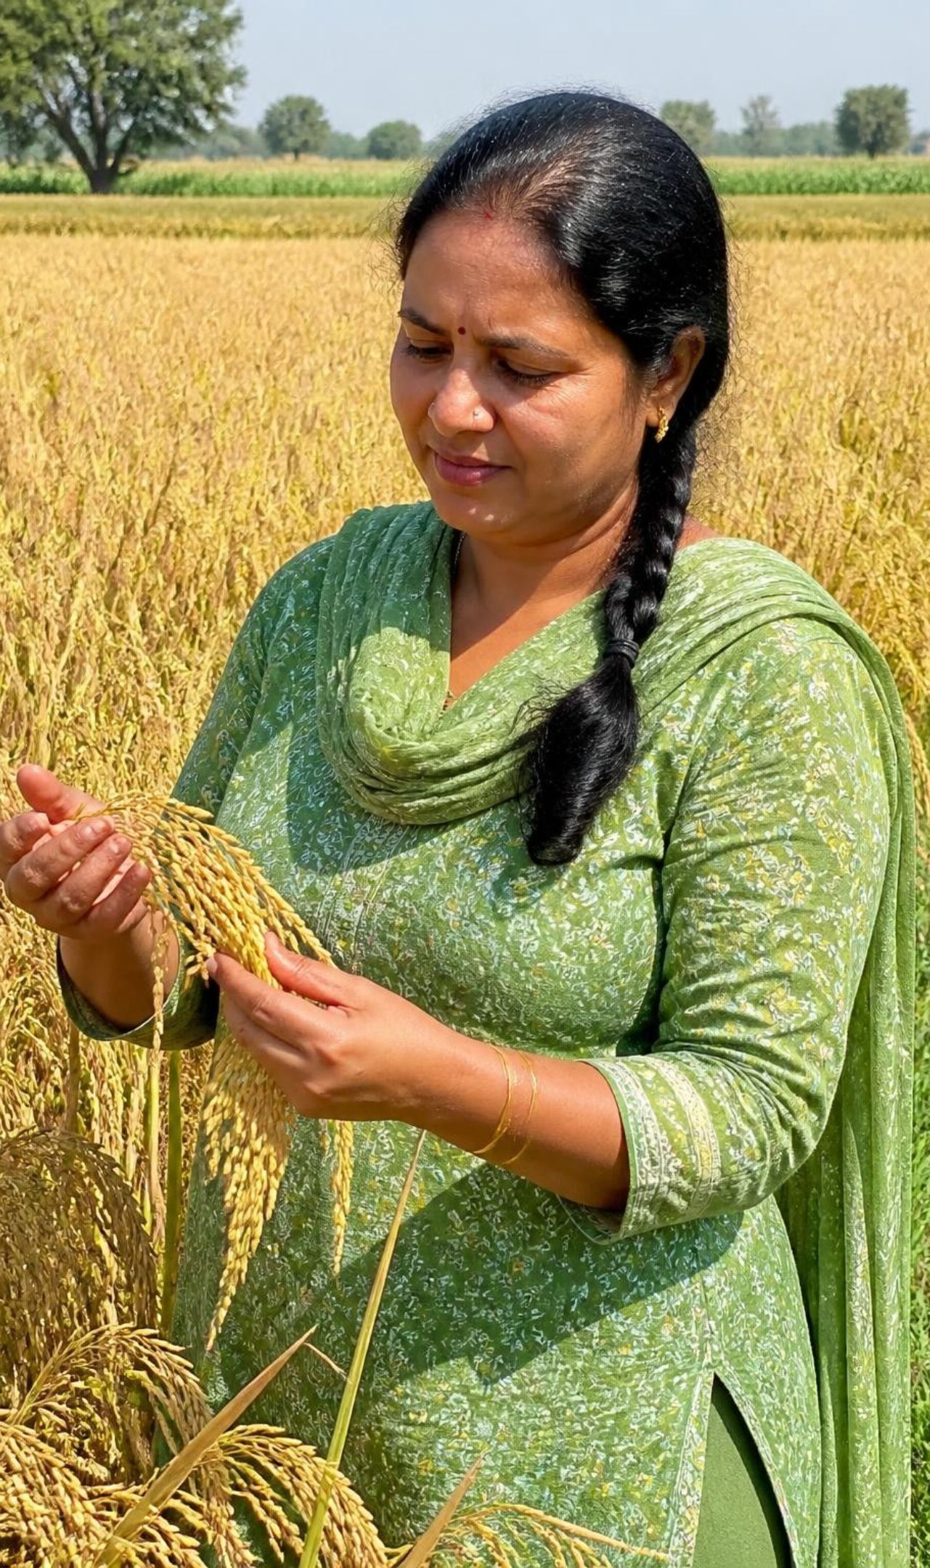
POTENTIAL FARMER VALUE
What farmers stand to gain
Before
With FieldShield AI
Manual checks.
Risks noticed late.
Limited timely insight.
Monitoring around the clock.
Earlier risk awareness and real-time warnings.
More informed decisions.
Potential to reduce crop losses and manage farms more efficiently.

Slide 9
FUTURE SCOPE
Where FieldShield AI can grow
Available today
Future possibilities
Farm mapping
Eight risk modules
Alerts
Multilingual access
Deeper smart-farming tools
Wider regional coverage
More support for agricultural communities
Possibilities, not implemented features.

Slide 10
Protect Every Crop.
Reduce Every Loss.
FieldShield AI brings satellite-backed
protection to every farm.
https://fieldshield.ai.studio

